Slide 1
SYD366 Lab Presentation
Group-2

Slide 2
AGENDA
Sales Lab(Description)
Class Diagram(Sales Lab)
Sequence Diagram(Sales Lab)-4
Scheduling Lab(Description)
​Class Diagram (Scheduling Lab)
​Sequence Diagram (Scheduling Lab)-1

Slide 3
SALES MODULE
Linda is looking at expanding into online business, and since she’s looking at loyalty programs, recording customer information is important to her. Recording sales from her website is easy, but recording sales at their kiosks is problematic. Some customers simply do not want give their personal information, so Linda is comfortable with recording these sales to one ‘customer’ by location.
At the end of the day, Linda would like the ability to query purchases – minus sales by location so that she can adjust inventory to account for unrecorded sales.
Your task is to create a class diagram and sequence diagrams to support the following user stories and systems use case specifications.

Slide 4
USER STORY
Use Case: Maintain Customer
As the owner of this business, I would like to record contact information for my customers.
Acceptance Criteria:
Must be able to flag customers as no longer active.
Must be able to query customers.
Must be able to query sales by company.

Slide 5
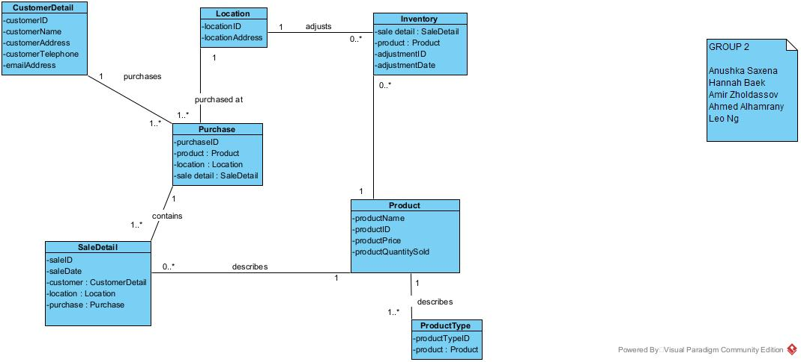
Class Diagram

Slide 6
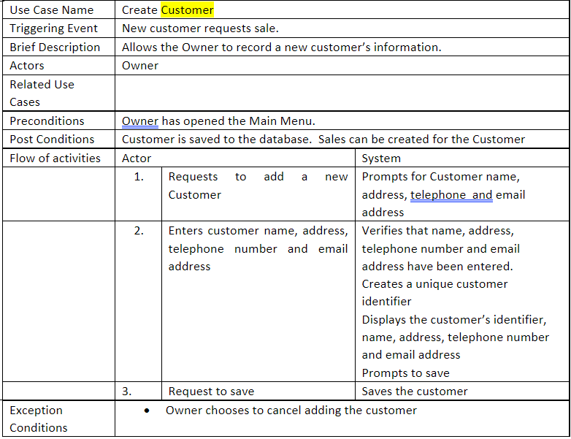
case description-1

Slide 7
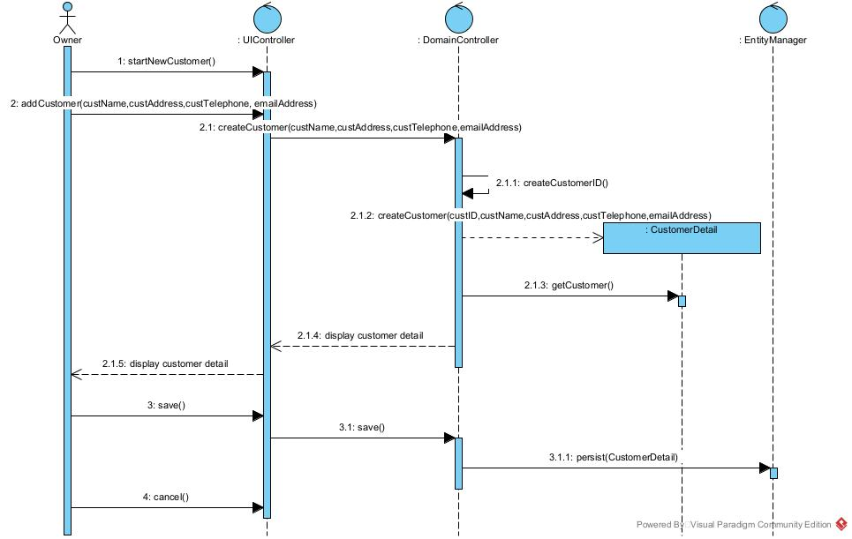
Sequence diagram

Slide 8
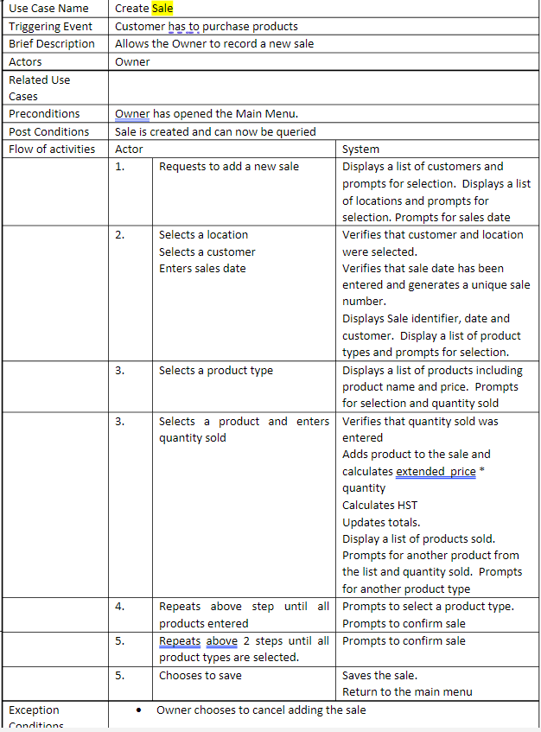
case description-2

Slide 9
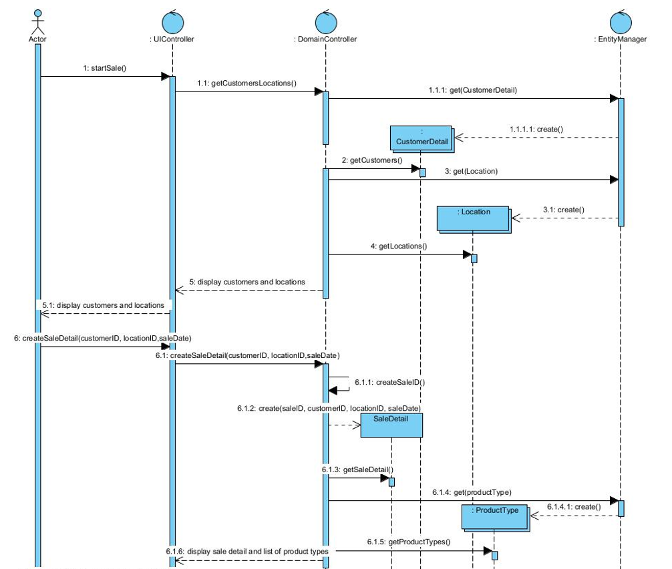
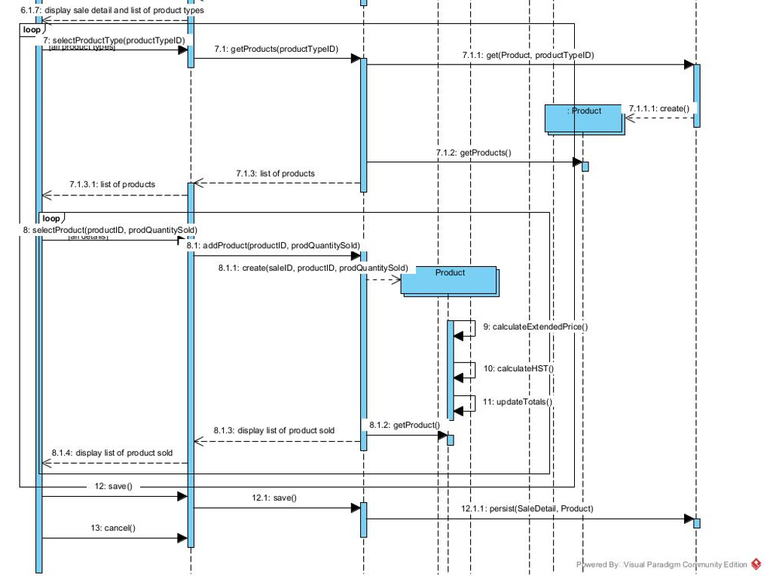
Sequence diagram

Slide 10
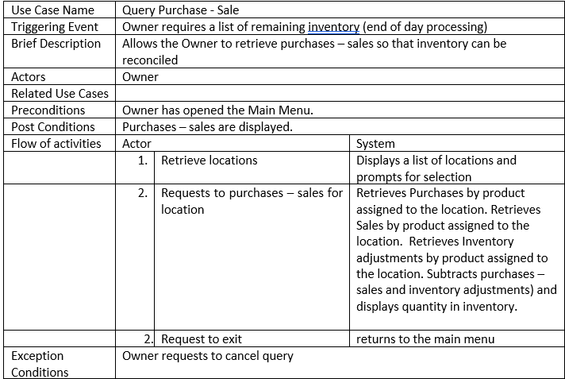
case description-3

Slide 11
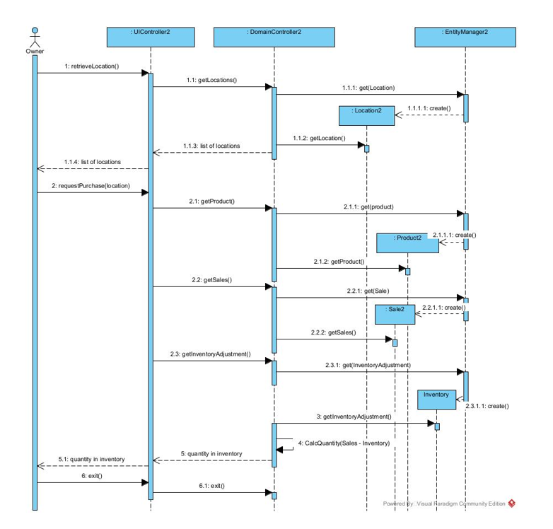
Sequence diagram

Slide 12
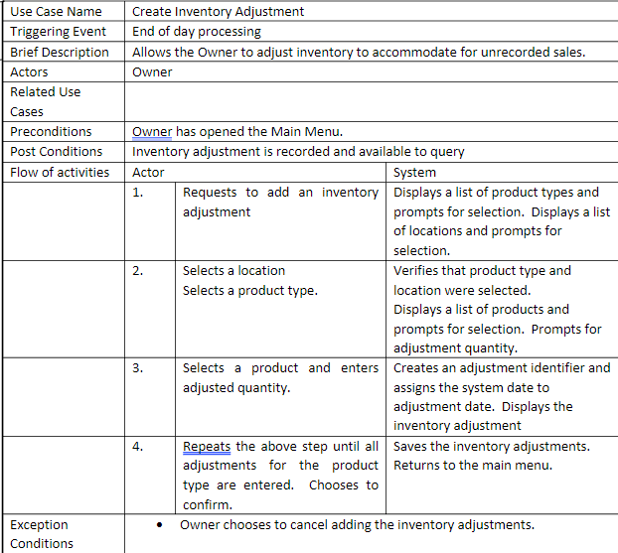
case description-4

Slide 13
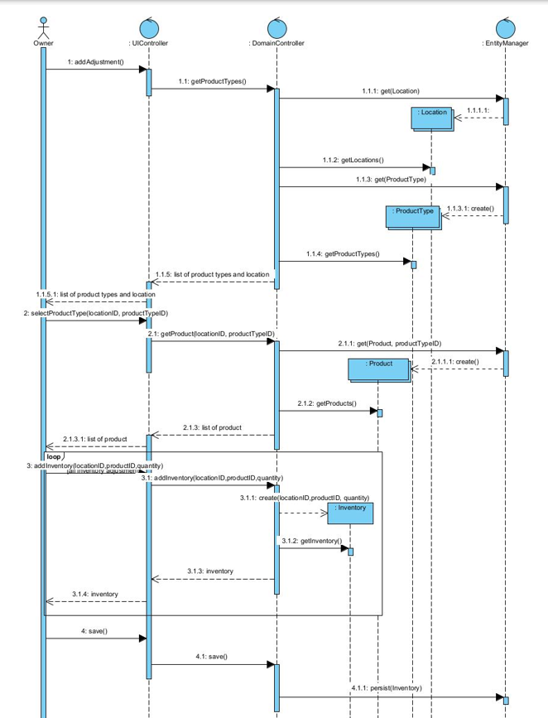
Sequence diagram

Slide 14
Scheduling module
Linda finds it difficult to manage employee schedules for multiple locations.
Different locations have different set hours with some locations staying open late most evenings. Linda prefers to have longer term employees (Keyholders) always on site.
Linda would like to schedule workshifts for her employees.

Slide 15
User story
As the owner of this business, I would like to schedule workshifts for my employees by location.
Acceptance Criteria:
Must be able to record multiple workshifts for an employee at one time.
Must be able to query workshifts by location.
Must be able to query workshifts by employee.

Slide 16
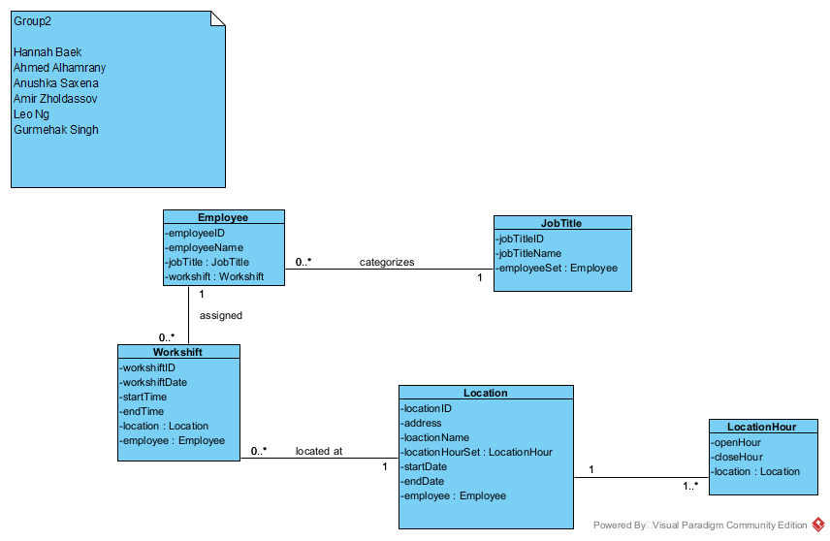
Class diagram(Scheduling Lab)

Slide 17
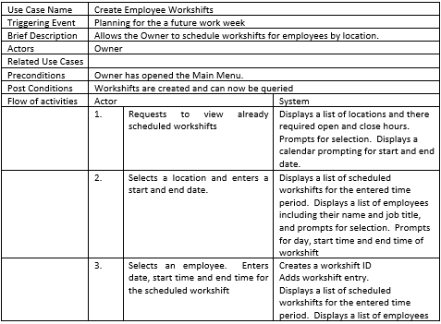
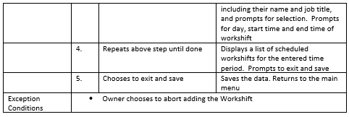
case description-1

Slide 18
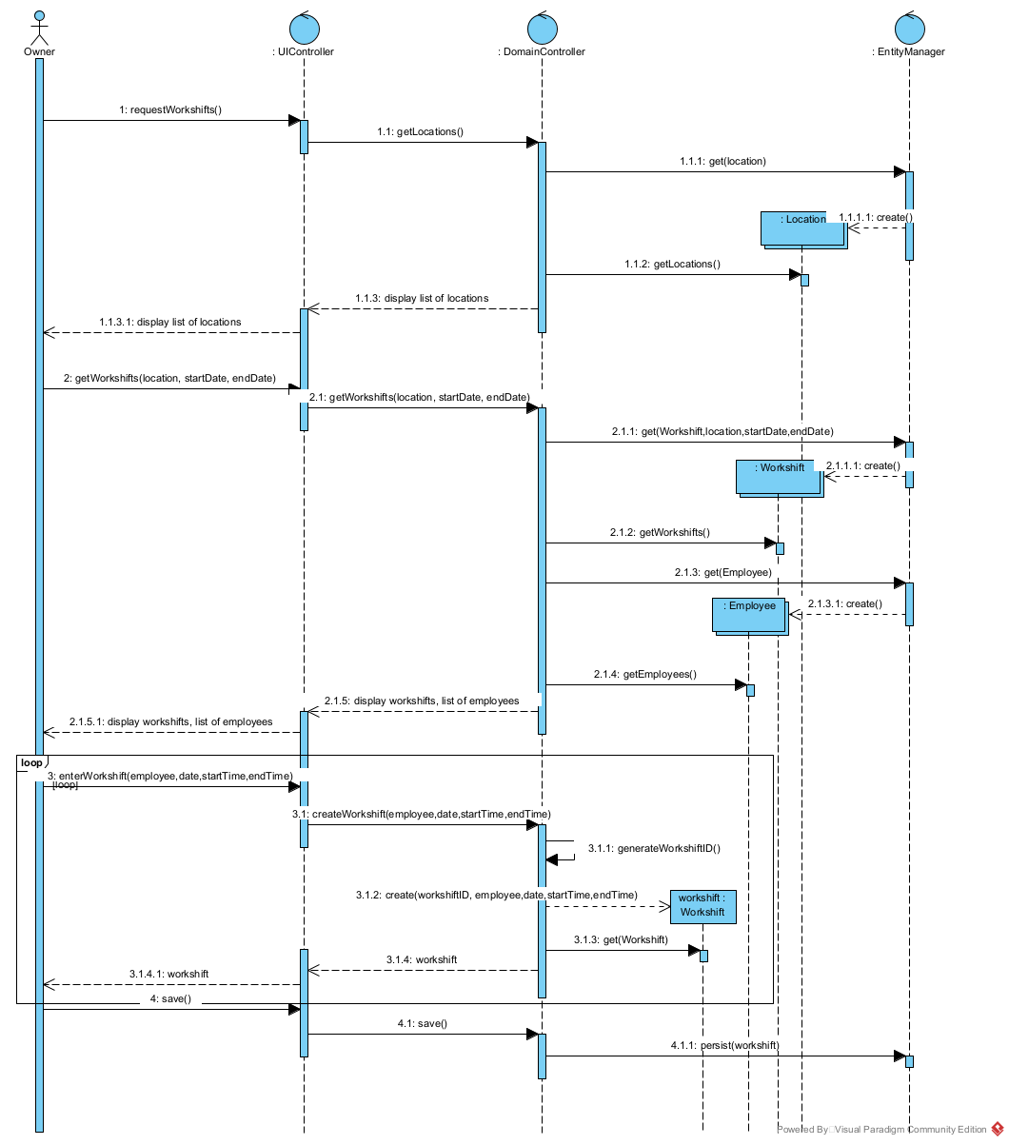
Sequence diagram

Slide 19
THANK YOU
Anushka Saxena

